Slide 1
Pointing and Fitts Law CSCI 3002 Fall 2018
Notes:
Image: Huffington Post, https://www.huffingtonpost.co.uk/2011/07/07/why-my-children-don-t-need-wii-hab_n_7387446.html

Slide 2
Today
Laws of human performance
Or: how to use human tricks to design things better

Slide 3
Catching up from last week
What do you think about Brian Baker’s talk?
A guest speaker Dan Ligon on Nov 15
Shaun was at the ACM ASSETS conference in Galway, Ireland
A few interesting things from ASSETS…
Notes:
It’s exciting that you can do this stuff as a job!

Slide 4
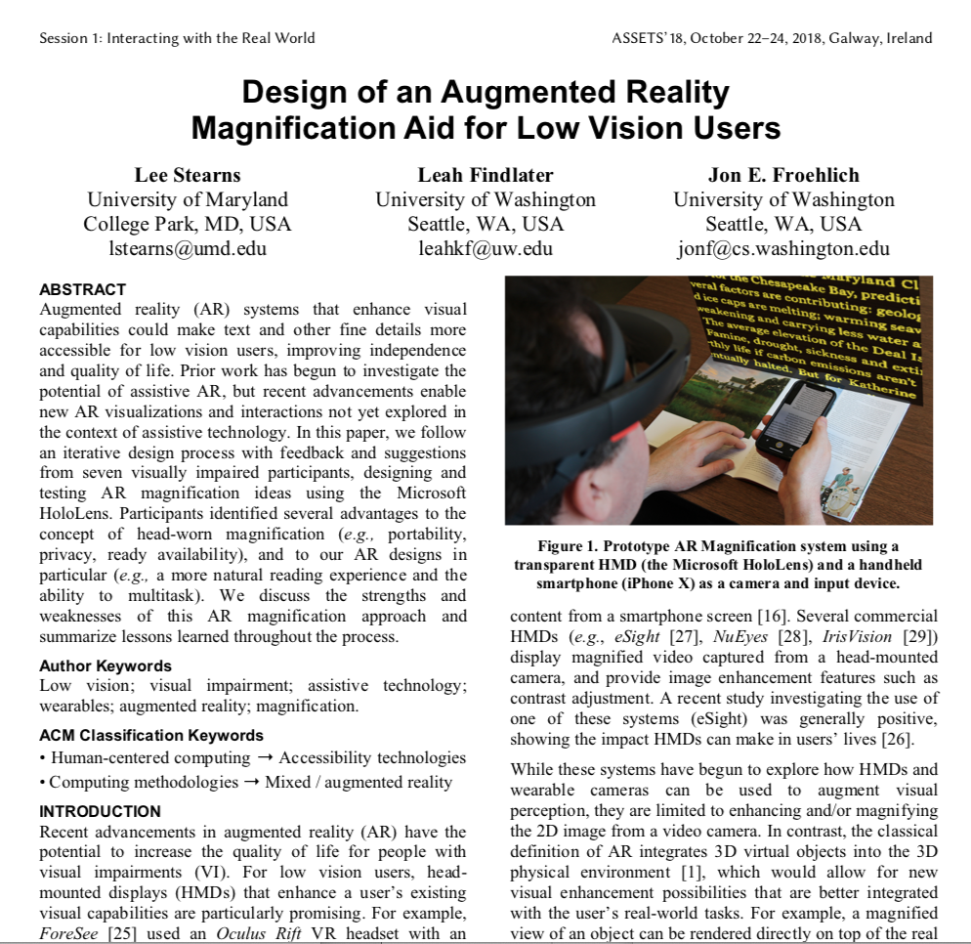
Notes:
https://dl.acm.org/citation.cfm?id=3236361

Slide 5
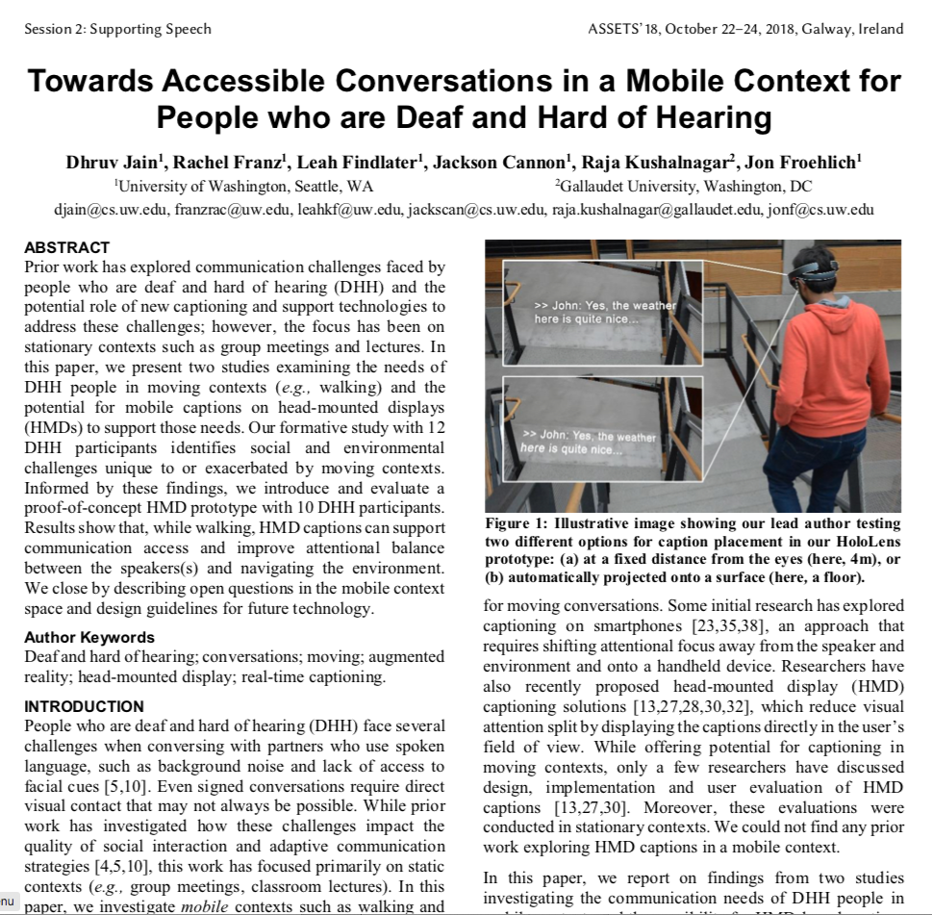
Notes:
https://dl.acm.org/citation.cfm?id=3236362

Slide 6
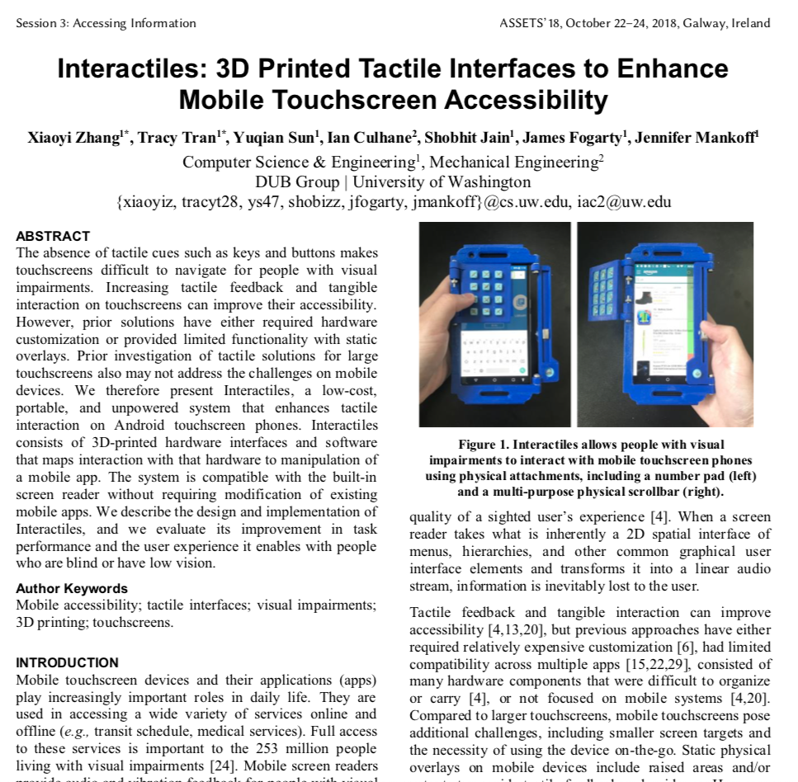
Notes:
https://dl.acm.org/citation.cfm?id=3236349

Slide 7
Norman’s Design of Everyday Things
Added Chapter 1 PDF to Canvas
Highly recommend reading it
Whole book is worth reading
Big idea: we can understand why interfaces work (or don’t) by understanding the cognitive processes of using them
Big idea 2: it’s easy to get distracted by UI frameworks, widgets, etc. – but these rules apply even to very simple things
Notes:
Looking at simple objects helps us get outside our own head and preconceptions.

Slide 8
Syncing up from last week
Some big ideas
Heuristic evaluation
Norman (affordances, constraints, feedback, gulfs of execution/evaluation, mapping, system model)
These are important topics, and I want to make sure that you have a good grasp of them
So… let’s do some clicker questions
Notes:
We’ll fill in the gaps where we need to

Slide 9
Clickers out 🎮 Get a piece of paper out

Slide 10
Clicker Q1
Who is the primary source of feedback during a heuristic evaluation?
The original designer of the system
The person conducting the evaluation
The end user of the system
A focus group of end users

Slide 11
Clicker Q1 - Answer
Correct answer: B, The person conducting the evaluation
Heuristic evaluation is a technique in which the tester checks the user interface against a set of known good practices

Slide 12
Clicker Q2
What is the gulf of execution?
The difference between the designer’s perspective and the user’s perspective
Lag time between when the user clicks and the UI responds
When the user doesn’t know whether their action was completed
When the user doesn’t know how to perform an interaction

Slide 13
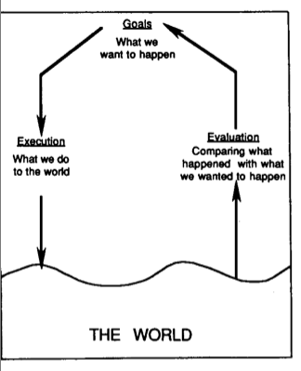
Clicker Q2 - Answer
Correct answer: D, When the user doesn’t know how to perform an interaction
Norman’s action cycle consists of goals, execution, evaluation (in that order)

Slide 14
Clicker Q3
How do constraints help in a design?
They make the user interface simpler
They make it more difficult to perform “incorrect” actions
They reduce the amount of time needed to complete the design
They don’t, they actually make design worse

Slide 15
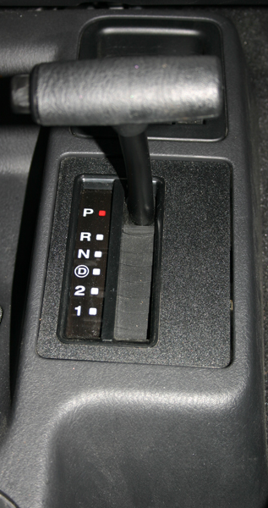
Clicker Q3 - Answer
Correct answer: B, They make it more difficult to perform “incorrect” actions
If we never want to go directly from reverse to drive, don’t tell the user that, just don’t make that an option

Slide 16
Clicker Q4
Which of these is an affordance?
A chair has a butt-sized flat surface
A new app has a pop-up instruction screen
A blue hyperlink is clickable
An application offers a help function

Slide 17
Clicker Q4 - Answer
Correct answer: A, chair has a butt-sized flat surface
An affordance invites the correct action in its design, without explicit instructions
Affordances suggest actions and constraints limit them (but the boundary is fuzzy)
Notes:
Chair picture: https://www.wayfair.com/furniture/sb1/red-accent-chairs-c416225-a75218~274798.html

Slide 18

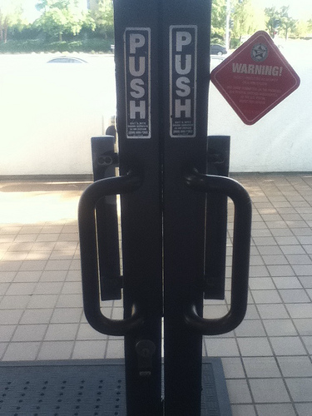
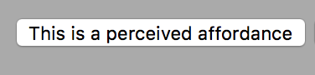
These are NOT affordances
If you need instructions or have to guess, your affordance isn’t working.

Slide 19
Conventions vs. affordances
Conventions are anything that we have to learn
Would an alien (or someone who has been in a coma for 30 years) know what to do?
These are effectively arbitrary (in the mirror universe, _{hyperlinks look like this})
Affordances, constraints, mappings etc. are designed to fit the action
If you changed them, they wouldn’t work anymore (you wouldn’t sit on a 50% width chair)
They’re not magic – you still need to discover them (and may miss them)

Slide 20
Clicker Q5
Which is an example of a natural mapping?
Turning a knob clockwise increases volume
Flicking a light switch up turns the light on
Sliding a dimmer switch up increases the light level
Pushing a wheelchair joystick forward moves the wheelchair forward
None of the above

Slide 21
Clicker Q5 - Answer
Correct answer: D, Pushing a wheelchair joystick forward moves the wheelchair forward
Some of these are conventions (clockwise = more, up = more)
Natural mappings involve no conversion
Push this way
Move this way
Notes:
Image: https://www.youtube.com/watch?v=IOMAMy-1OHU

Slide 22
Natural mappings
No :(
Yes :)
Notes:
A common response to this is “yeah but anyone can figure this out.” I’m not saying people can’t figure this out. But we want to be conscious about what’s going on – in this case, someone has to learn a mapping

Slide 23
Clicker Q6
Should we do these quizzes more often?
Yes
No
No opinion
Notes:
Chair picture: https://www.wayfair.com/furniture/sb1/red-accent-chairs-c416225-a75218~274798.html

Slide 24
Questions on these topics?

Slide 25
Laws of human performance

Slide 26
The big idea
Human interaction is guided by previously-observed rules
We can derive useful guidelines from these rules
Serve as basis for performance tests
We can also use these rules to appoximately model activities

Slide 27
Two basic types of input in HCI
Text entry
Pointing

Slide 28
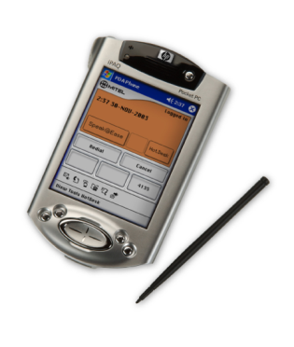
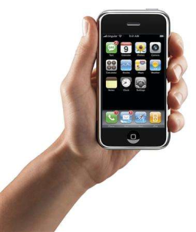
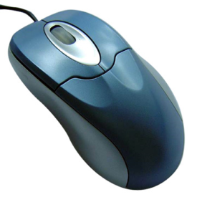
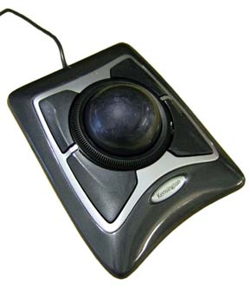
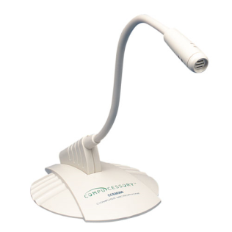
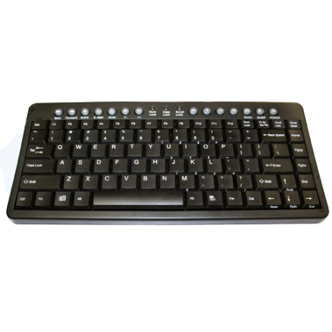
Many different types of input devices

Slide 29
Historical foundations
The mouse, developed by Douglas Engelbart in 1968
“Mother of all demos”: https://www.youtube.com/watch?v=yJDv-zdhzMY
“The live demonstration featured the introduction of the computer mouse, video conferencing, teleconferencing, hypertext, word processing, hypermedia, object addressing and dynamic file linking, bootstrapping, and a collaborative real-time editor.”

Slide 31
Ivan Sutherland, Sketchpad (1963)
Light pen, direct manipulation
https://www.youtube.com/watch?v=6orsmFndx_o

Slide 32

Archive of historical input devices
Billbuxton.com

Slide 33
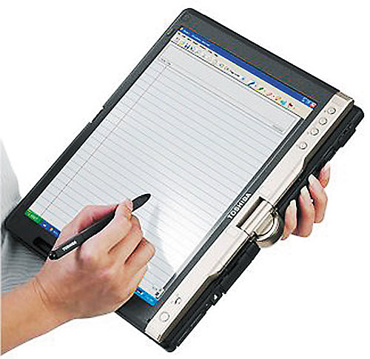
Understanding movement
Fast, imprecise ballistic movement
Precise, iterative corrective movement
This is closed loop movement
Open loop (e.g. throwing a dart) not governed by same rules
Notes:
I want you all to grab a pen

Slide 34
Fitts’ Law
Developed by Paul M. Fitts in 1954
Fitts, Paul M.; Peterson, James R. (February 1964). "Information capacity of discrete motor responses". Journal of Experimental Psychology 67 (2): 103–112. doi:10.1037/h0045689
Designed to model reciprocal pointing tasks

Slide 35
Reciprocal point-select tasks
Notes:
Fitts law task
Important to note: this is a 1D task!

Slide 36
What can Fitts’ Law tell us?
We can use Fitts’ Law to predict performance on a pointing task
Remarkably robust across devices, even underwater!
We can use Fitts’ Law to compare different interfaces or pointing devices
Theory from psychology that directly impacts user interface performance

Slide 37
What factors go into Fitts’ Law?
Movement time = size of the target + distance to target

Slide 38
Fitts’ law
MT = a + b log₂(A / W + 1)
What kind of equation does this remind you of?
y = mx + b
MT = a + bx, where x = log₂(A / W + 1)
x is called the Index of Difficulty (ID)
b is a slope

Slide 39
Fitts’ law
MT = a + b log₂(A / W + 1)
MT = movement time

Slide 40
Fitts’ law
MT = a + b log₂(A / W + 1)
MT = movement time
ID = index of difficulty

Slide 41
Fitts’ law
MT = a + b log₂(A / W + 1)
MT = movement time
ID = index of difficulty
A = amplitude (distance)

Slide 42
Fitts’ law
MT = a + b log₂(A / W + 1)
MT = movement time
ID = index of difficulty
A = amplitude (distance)
W = target width

Slide 43
Fitts’ law
MT = a + b log₂(A / W + 1)
MT = movement time
ID = index of difficulty
A = amplitude (distance)
W = target width
a and b are constants (empirically determined for each device/condition)

Slide 44
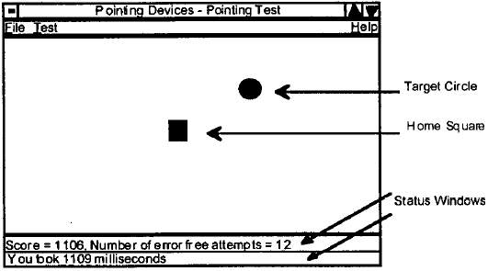
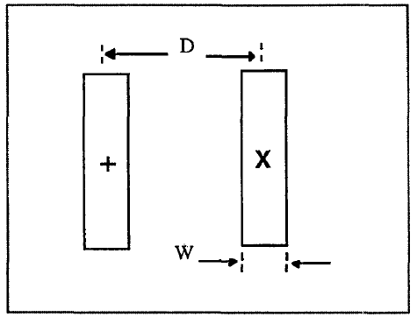
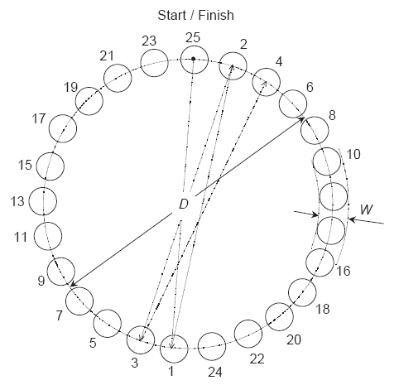
Fitts’ Law tasks
Discrete 2D pointing
Reciprocal 1D pointing
Circular
pointing

Slide 45
What can Fitts’ Law tell us?
MT = movement time
ID = index of difficulty
how difficult is the task?
IP = index of performance

Slide 46
Index of difficulty (ID)
log₂(A / W + 1)
What happens when A increases? When W increases?
Fitts’ law claims that the time to acquire a target (MT) goes up linearly with the log of the ratio of the movement distance (A) to target width (W)
Why is it significant that it is a ratio?
Units of A and W don’t matter!
Allows us to compare across different experiments
ID units in “bits”
Because of association with information capacity and somewhat arbitrary use of base-2 for the logarithm.

Slide 47
Index of performance (IP)
1/b is called Index of performance (IP)
If MT is in seconds, IP is in bits/second
“Slope” of the line
Also called throughput or bandwidth

Slide 48
Calculating index of performance
MT = a + b log₂(A/W + 1)
MT = a + b ID
MT/ID = b // drop ‘a’ as it is usually small
1/b = ID/MT
= throughput in bits/s

Slide 49
Using Fitts’ Law
Comparing multiple devices
Comparing multiple users
Predicting use

Slide 50
Fingers and thumbs
Example: Compare index fingers to thumbs
Use a range of target sizes (W) and movement distances (A)
A range of Index of Difficulties (IDs)
Do all combinations with both fingers
What can we conclude?

Slide 51
Data
Which finger has better performance?
Index Finger
Thumb
Movement Time
MT = a + 0.25 ID
b = 1/0.25 = 4.00 bits/s
Movement Time
MT = a + 0.50 ID
b = 1/0.50 = 2.00 bits/s
Index of Difficulty
Index of Difficulty

Slide 52
Other comparisons
Devices: trackballs vs. mice
Limbs: fingers vs. forearms
Populations: elders vs. children

Slide 53
What about error?
Fitts’ Law is about speed, not accuracy
In fact, Fitts’ Law assumes a 4% error rate
Can correct our data post-hoc if it doesn’t fit
In most interaction, we face speed/accuracy trade-offs
Later models have focused on measuring errors

Slide 54
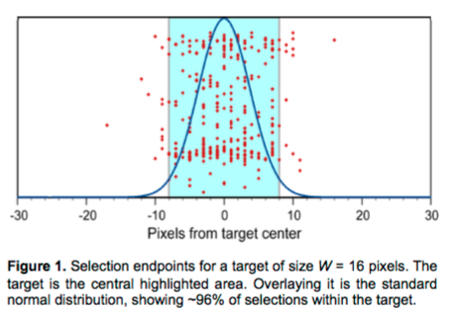
Jacob O. Wobbrock, Edward Cutrell, Susumu Harada, and I. Scott MacKenzie. 2008. An error model for pointing based on Fitts' law. In Proceedings of the SIGCHI Conference on Human Factors in Computing Systems (CHI '08). ACM, New York, NY, USA, 1613-1622. DOI=http://dx.doi.org/10.1145/1357054.1357306

Slide 55
Let’s try it
Design a 12-key keypad that Fitts Law tells us should be good
Design a 12-key keypad that Fitts Law tells us should be bad

Slide 56
Taking advantage of Fitts’ Law in designs
Knowing that Fitts’ Law holds true, what can we do to improve performance of our designs?
MT = a + b log₂(A / W + 1)

Slide 57
Improving performance
Performance will be improved when targets are nearby and large

Slide 58
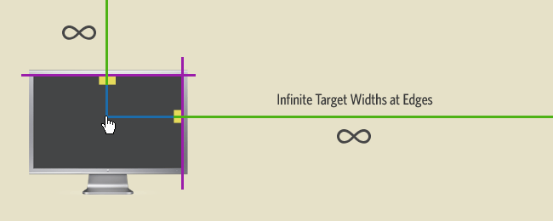
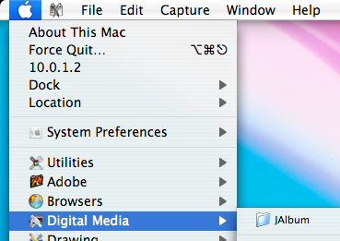
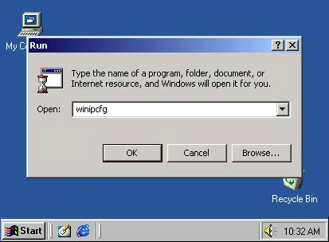
Edges and corners have infinite size

Slide 59
Radial menus
Menu options surround the cursor?
What does Fitts Law’ say about these?

Slide 60
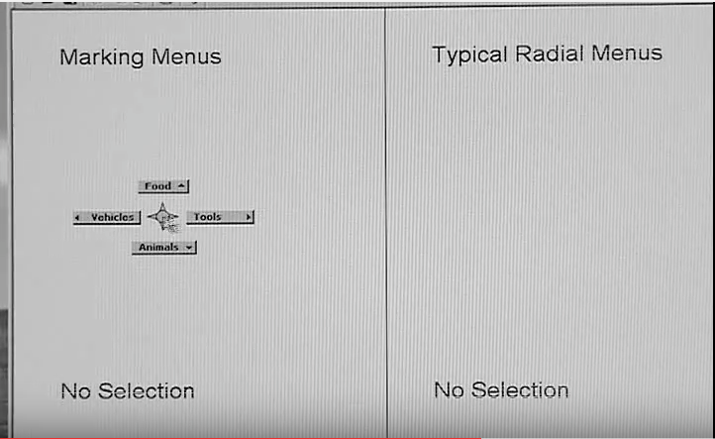
Marking menus
https://www.youtube.com/watch?v=dtH9GdFSQaw

Slide 61
Reducing pointing performance
Are there times when we want to increase the difficulty of acquiring a target?
Notes:
what are srcs of variation?

Slide 62
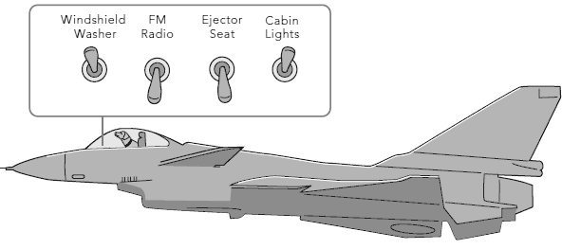
Reducing pointing performance
Are there times when we want to increase the difficulty of acquiring a target?
What does Fitts’ Law tell us?
Notes:
what are srcs of variation?

Slide 63
Visual area vs. target area
Sometimes the hit area of the target (the “clickable” area) can be different than the on screen target size

Slide 64
Visual area vs. target area
Sometimes the hit area of the target (the “clickable” area) can be different than the on screen target size

Slide 65
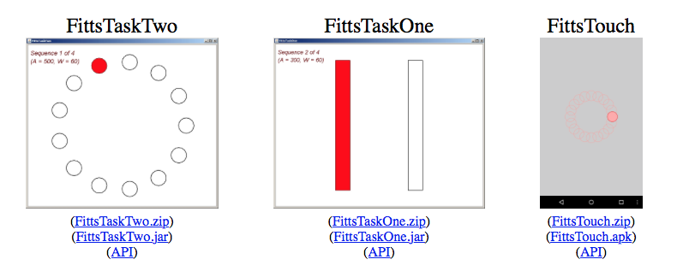
Testing Fitts’ Law
Many tools for testing different input devices
E.g. http://www.yorku.ca/mack/FittsLawSoftware/

Slide 66
Can we beat Fitts’ Law? How?
(this is called pointing facilitation)
Snap to target -> magnetic pointing
Reposition pointer

Slide 67
Area cursors
Cursor hot spot is no longer just a single point
But an entire area
What are the Fitts’ law properties of this design?

Slide 68
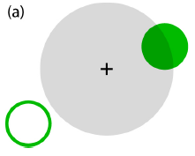
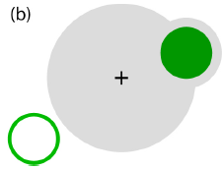
Bubble cursor
Grossman & Balakrishnan 2005
Dynamically resize an area cursor to contain the closest target but not the second closest.
Use a second bubble when the main area cursor intersects but does not fully contain a target.
http://www.dgp.toronto.edu/~tovi/videos/bubblercursor.mov
(Grossman & Balakrishnan, 2005)

Slide 69
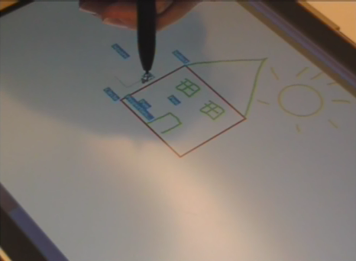
Hover Widgets
Use hover state of a stylus to access nearby targets
Effectively adding more input capabilities
Grossman et al.
https://www.youtube.com/watch?v=WPbiPn1b1zQ

Slide 70
Limitations
Fitts Law is an approximation (but one that happens to work well)
Doesn’t tell us anything about underlying mechanisms
But is useful for design…

Slide 71
Other laws of human performance

Slide 72
Other laws
Movement: Schmidt’s law (1979) and Minimum jerk law (Hogan 1984)
Power law of practice (Snoddy 1926)
Hick-Hyman law of choice reaction time (Hick 1952, Hyman 1953)
Kinematic chain model of bimanual interaction (Guiard 1987)
Weber’s law of Just Noticeable Differences (Weber 1834)
Zipf’s law of token frequencies in languages (Zipf 1935)
Model-Human Processor (MHP)
More details at the end of the slides…

Slide 73
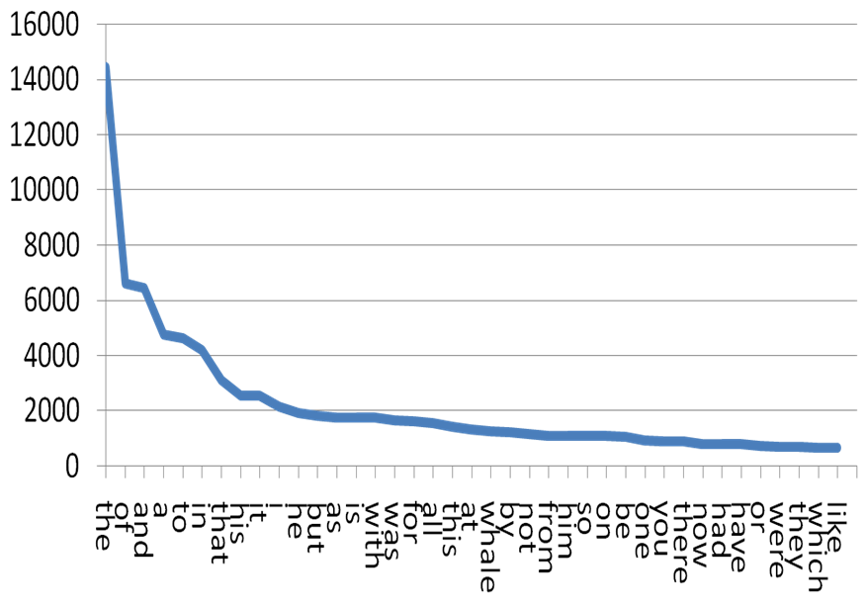
Token frequencies in language Zipf’s law (1935)
A word’s frequency is inversely proportional to its rank
Words from Moby Dick
Notes:
Included this one because it’s very relevant

Slide 74
Modeling human performance

Slide 75
Modeling human performance
If we know how long it takes for elementary operations…
… and we can identify the elementary operations to complete a task…
…we can (roughly) estimate task performance

Slide 76
Model Human Processor (MHP) (Card et al., 1983)
Approximate predictions of gross human behavior
Unify perception, cognition, and action
Provide “good enough” answer to guide design
Provide explanation for and support empirical results

Slide 77
Demonstration
When I clap,
you knock on the table

Slide 78
What just happened?
Three interacting systems
Perceptual (hear clap)
Cognitive (process clap)
Motor (respond with knock)
Each subsystem has
A processor
Memories (data)

Slide 79
Parameters
Memory
µ Storage capacity in items
∂ Decay time of an item
κ Code type (physical,acoustic,visual,semantic)
Processor
τ Cycle time – based on psych research

Slide 80
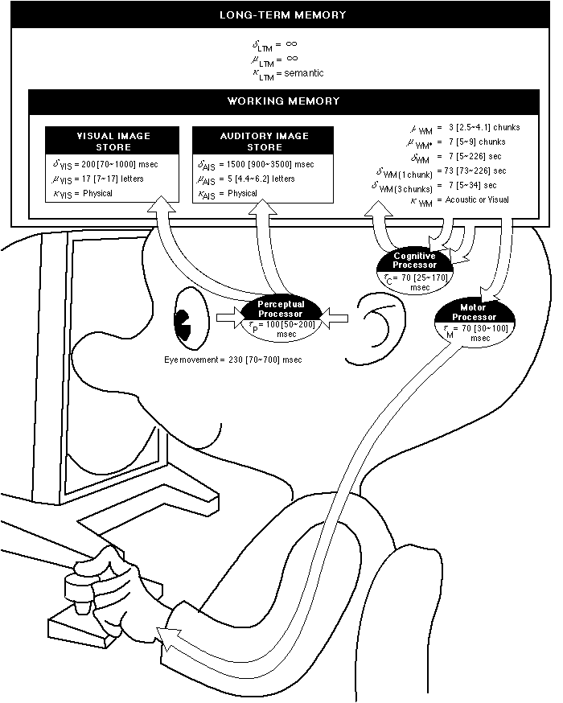
Notes:
Look at system, and different bottlenecks

Slide 81
Interacting subsystems

Slide 82
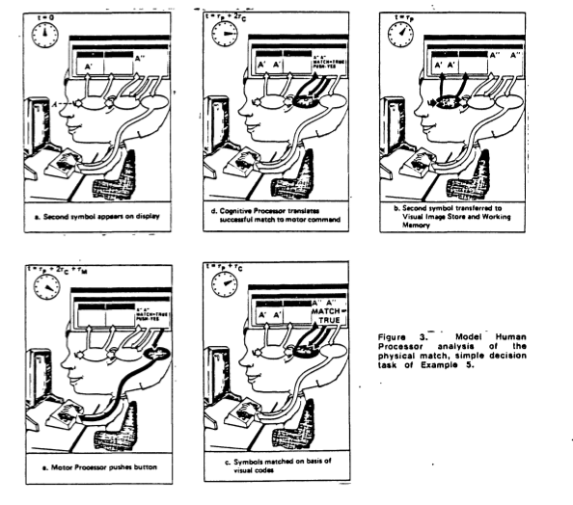

Slide 83
Notes:
Look at system, and different bottlenecks

Slide 84
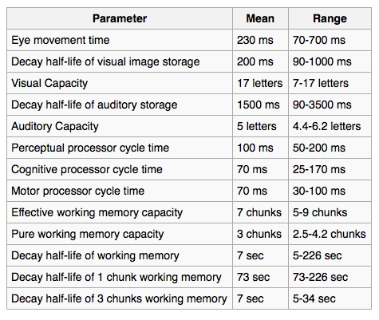

Slide 85
Other modeling tools
GOMS (Card, Moran, and Newell)
Model goals, operators, methods, selection
KLM (Card, Moran, Newell)

Slide 86
Keystroke-Level Model
Part of the GOMS family, but focusing on low level interactions
Simplify mental work
Can be useful for modeling UI tasks

Slide 87
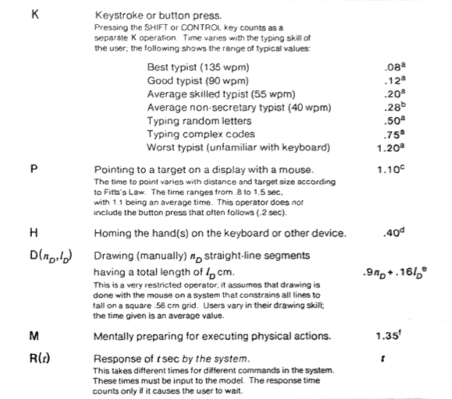
Notes:
Anything missing? i.e. visual search

Slide 88
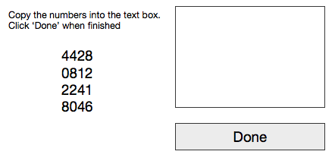
KLM Activity
Sketch out the KLM steps for the following activity
K – keystroke
P - pointing @ target
H – homing hands on device
D – drawing shape
M – mental preparation
R – system response time

Slide 89
KLM Activity
One model:
Can we make it faster?

Slide 90
Is this useful?
Talk with your neighbor
When can this type of modeling be useful?
When would it not be useful?

Slide 91
Questions MHP can answer
How long will it take to do a task on the computer?
Will design A be faster than design B?
Why is design A faster than design B?
Questions MHP cannot answer
User preferences
Complex problem-solving, learning
Questions about the subtleties of human behavior, creative thoughts, humor etc.

Slide 92
Limitations
Doesn’t really account for complex tasks, multitasking
But can be useful with mobile devices, very simple user interfaces

Slide 93
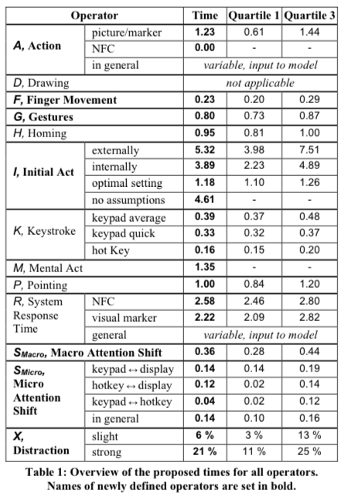
Paul Holleis, Friederike Otto, Heinrich Hussmann, and Albrecht Schmidt. 2007. Keystroke-level model for advanced mobile phone interaction. CHI '07.

Slide 94
For Thursday
We’ll be running performance experiments (Fitts study or typing performance)
Groups of 3-4 (to make this manageable)
Bring a Windows computing device (if you can)
Bring a hypothesis that you can test
Bring any needed accessories (e.g. mice)
Ideas:

Slide 95
Brainstorming test ideas

Slide 96
Bonus

Slide 97
Closed loop vs. open loop motion

Slide 98

Closed loop, open loop
What is closed loop motion?
Rapid aimed movements with feedback correction
Fitts’ law models this

Slide 99
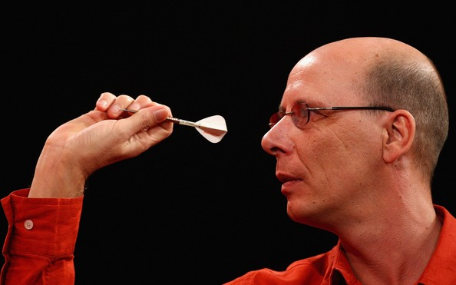
Closed loop, open loop
What is open loop motion?
Ballistic movements without feedback correction
Example: Throwing a dart!
Schmidt’s law (1979) models this

Slide 100
Direct vs. indirect pointing
direct: input occurs co-located with output
indirect: input occurs separated from output
issue: hand occlusion
issue: 2 possible foci-of-attention

Slide 101
Absolute vs. relative pointing
relative: changes in input space are reflect- ed in output space; (dx,dy) matter.
absolute: input space is mapped to output space;
(x,y) matter.

Slide 102

Clutching
Happens in relative pointing when the device reaches the limits of its movement range
The device must be manipulated out of sensing range to re-establish its sensed range of motion.
Mouse: lift the device, bring it back nearer to yourself, and move it again
Trackball: lift your thumb, place on near side of ball, and roll it again
Trackpad: Lift finger from edge of trackpad and move it to other edge

Slide 103
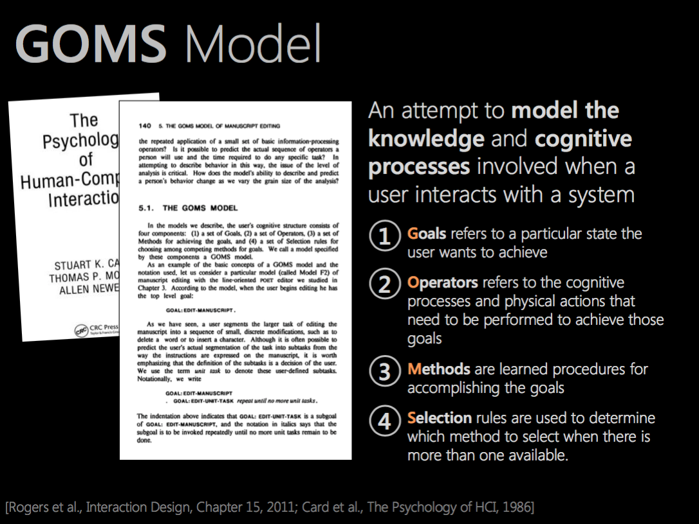
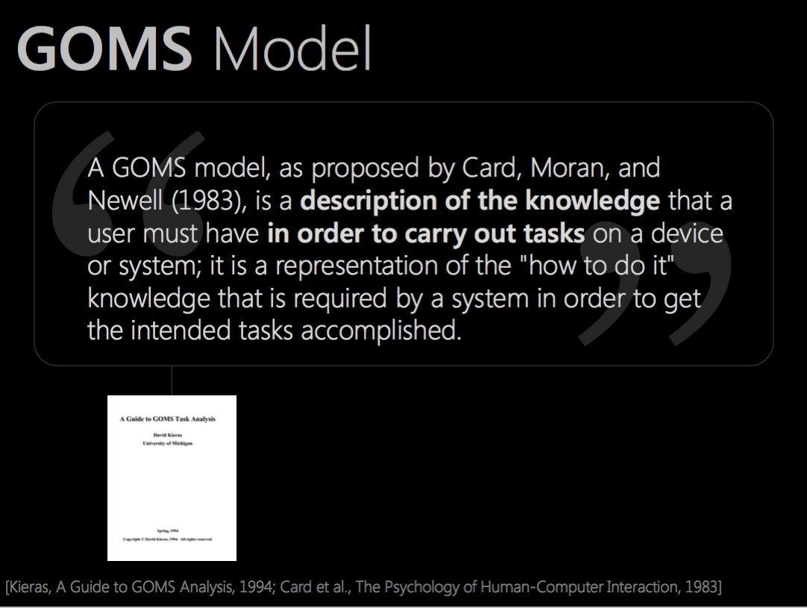

Slide 104
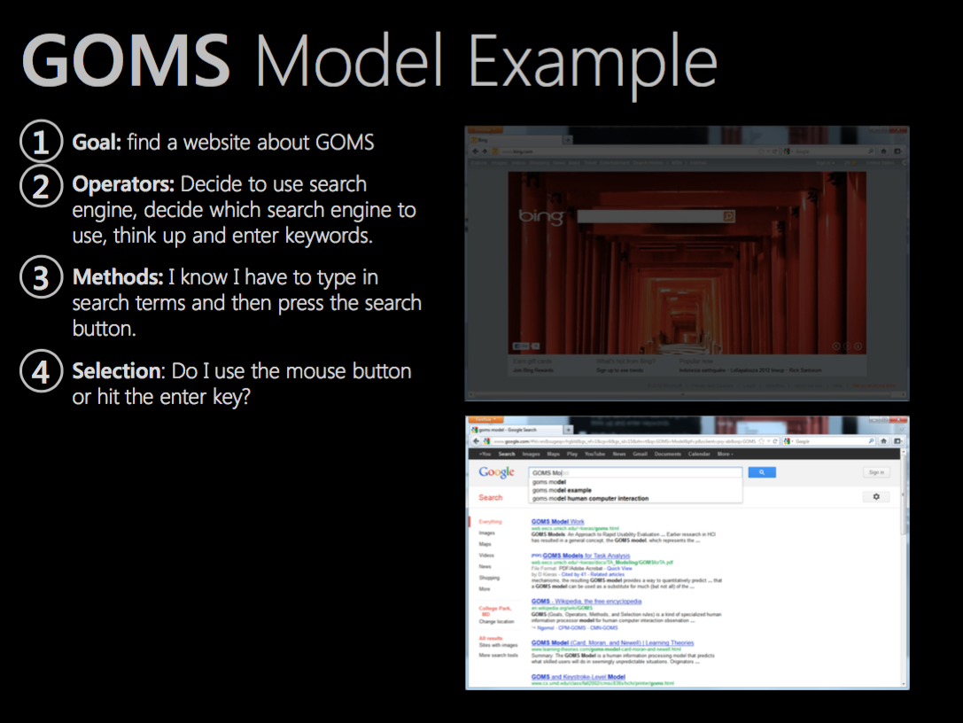

Slide 105
Power law of practice (Snoddy 1926)
Practice Choice-reaction Bimanual interaction
Just noticeable difference Token frequency Model human processor
Practice decreases task time
After n-1 trials of a task, task time on the nth trial is:
Applies to rote motor tasks, response times, etc.
Constant, typically
.2 to .6
Trial time
Time of first trial

Slide 106
Learning curve
Practice Choice-reaction Bimanual interaction
Just noticeable difference Token frequency Model human processor
(Reverse power law of practice)
Predicts rate of performance (increasing).
Regression exponent,
Typically .1 to .4
Trial time
Time of first trial

Slide 107
Predictive power
Practice Choice-reaction Bimanual interaction
Just noticeable difference Token frequency Model human processor
predictions
WPM

Slide 108
Choice reaction time Hick-Hyman law (1952, 1953)
Practice Choice-reaction Bimanual interaction
Just noticeable difference Token frequency Model human processor
Given n equally probable choices, time to choose among them is approximately
1/b often 5-7 bits/s for subjects in their 20s
Alternate version for unequal probabilities

Slide 109
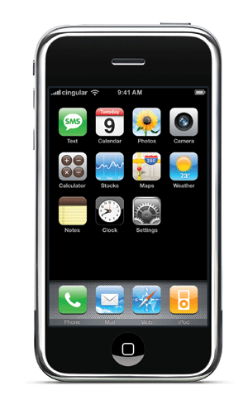
Using Hick-Hyman
Practice Choice-reaction Bimanual interaction
Just noticeable difference Token frequency Model human processor
n buttons and one button becomes highlighted. Click that button.
Can we apply it to menu design?
Notes:
Unequal probabilities?

Slide 110
Applications of Hick-Hyman
Practice Choice-reaction Bimanual interaction
Just noticeable difference Token frequency Model human processor
Calculate upper and lower bounds for stylus typing on soft keyboard
Model used Fitts’ law, key distances, key width, Hick-Hyman
Soukoreff, R. W. and MacKenzie, I. S. (1995) "Theoretical upper and lower bounds on typing speed using a stylus and soft keyboard." Behaviour and Information Technology 14 (6), pp. 370-379.

Slide 111
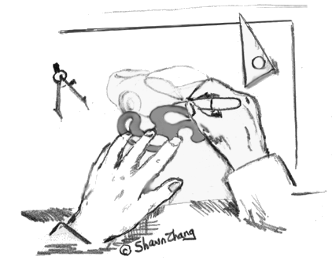
Bimanual division of labor Kinematic chain model (Guiard 1987)
Practice Choice-reaction Bimanual interaction
Just noticeable difference Token frequency Model human processor
Two hands play different roles
Left hand delineates “frames”
Right hand inserts “contents”
Left hand performs gross actions, right hand takes fine actions.
Left hand initiates manipulation

Slide 112

Just noticeable difference (JND) Weber’s law (1834)
Practice Choice-reaction Bimanual interaction
Just noticeable difference Token frequency Model human processor

Slide 113
Just noticeable difference (JND) Weber’s law (1834)
Practice Choice-reaction Bimanual interaction
Just noticeable difference Token frequency Model human processor
Minimum amount a stimulus needs to be changed to be detected by a (human) perceiver
Sound pitch differences
Sound loudness differences (at higher amplitudes)
Color brightness differences
Time intervals
Spatial intervals

Slide 114
Weber’s law (1834)
Practice Choice-reaction Bimanual interaction
Just noticeable difference Token frequency Model human processor
Ratio of the JND ∆I to initial stimulus I is a constant k across magnitudes of that stimulus
i.e., the JND is a constant proportion of the original stimulus value
Demo from Brad Wray

Slide 115
Design implications
Practice Choice-reaction Bimanual interaction
Just noticeable difference Token frequency Model human processor
For higher initial stimuli, must tolerate higher error
If user’s input must change, noticeable change is proportional to strength of original input
e.g., force generated on an isometric joystick
JND found for one level can be reused for other levels of that stimulus (within a reasonable range)

Slide 116
Pointing
Schmidt’s law
Minimum jerk law

Slide 117
Schmidt’s law (1979)
Open-loop pointing
Speed-accuracy tradeoff for timed, open-loop (ballistic) movement
“flinging” and “coasting”
Linear relationship, not logarithmic (like Fitts’ law)
Notes:
Applies to temporally constrained movements, e.g., tapping in time with a metronome
Not logarithmic tradeoff of Fitts’ law (aimed, corrective, closed-loop)

Slide 118
Minimum jerk law (Hogan 1984)
How do humans choose how to acquire a target? (degrees of freedom problem)
Claims that human movements attempt to minimize jerk, which is the change in acceleration over time
Smooth velocity profiles result in minimal jerk
Notes:
Intuitively why is this so? Reduces stress

Slide 119
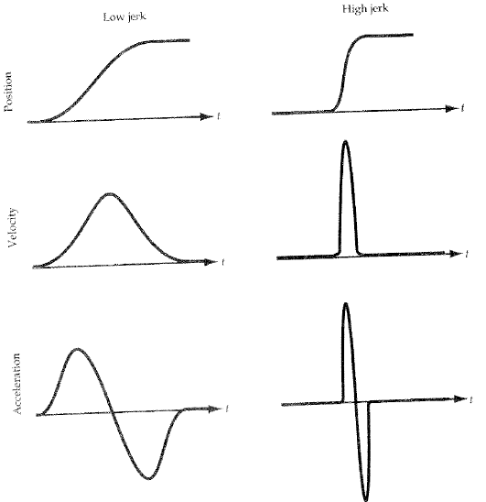

Slide 120
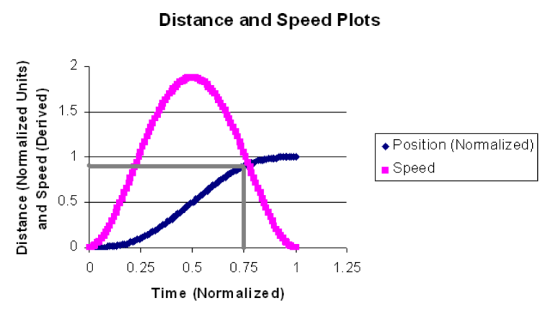
One use: endpoint prediction
If we know how a person moves, we might be able to predict where they will move
Lank, E., Cheng, Y.-C.N. and Ruiz, J. (2007) Endpoint prediction using motion kinematics. Proceedings of CHI ‘07. New York: ACM Press, 637-646.

Slide 121
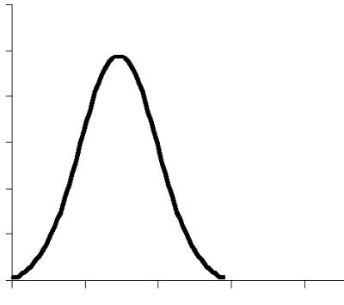
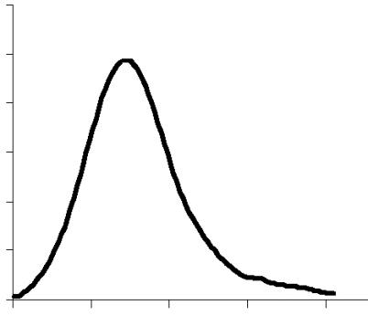
Problem with minimum-jerk
Movements often have “corrective tail” not predicted by the minimum jerk law
Velocity
Velocity
Time
Time

Slide 122
Cognitive biases
http://mentalfloss.com/article/68705/20-cognitive-biases-affect-your-decisions

